Slide 1
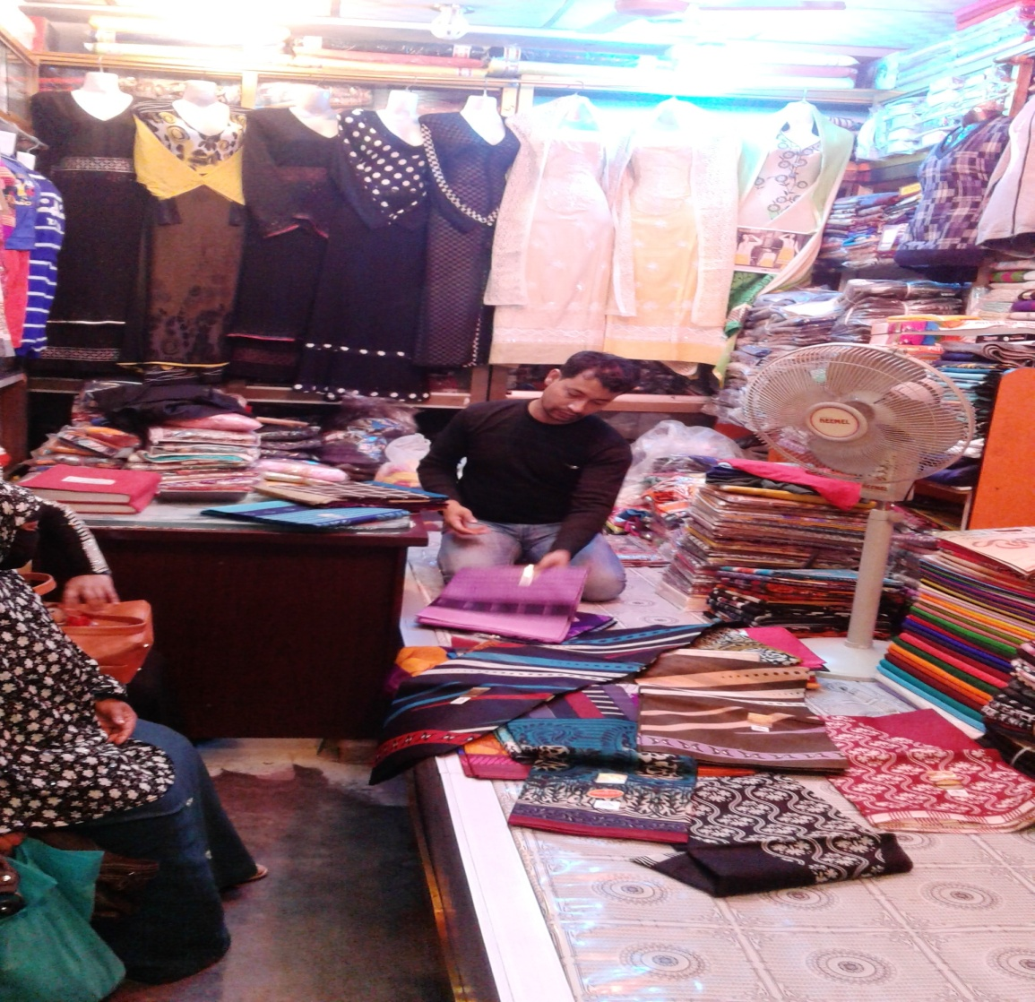
Al Arafat Fashion
Project by: Md. Sahadat Hossain
Identified by: Md.Billal Hossain
Verified By: Md. Zahidul Kabir
Noakhali Unit
Region -2
GRAMEEN TRUST

Slide 2
Brief Bio of the PROPOSED Nobin Udyokta
Name | : | Md. Sahadat Hossain
Permanent Address | : | Ramnagor, Begumgonj, Noakhali-3822.
Age | : | 16-Jan-1989 ( 27 Years)
Marital status | : | Married
Children | : | 02 Children
No. of siblings: | : | 05 Brothers, 03 Sisters
Parent’s and GB related Info (i) Who is GB member (ii) Mother’s name (iii) Father’s name (iv) GB member’s info Further Information: (v) Who pays GB loan installment (vi) Mobile lady (vii) Grameen Education Loan Any other loan like GCCN, GKF | : : : : : : : : | Mother Father Samsun Nahar Abdul Kashem Branch: Jirtoli, Begumgonj, Centre :17/m Group no :04, Loanee no.: 2239/1, Member since: 2012 to Still Now. First loan: 10,000/-, Existing loan: 20,000/-, Outstanding: 10,710/- N/A N/A N/A N/A N/A
Education | : | Class Eight

Slide 3
Brief Bio of the PROPOSED Nobin Udyokta (cont…)
Present Occupation | : | Cloth Store Collect raw materials from Chowmohani Bazar. Local Consumer are the target group.
Initial Investment | : | 50,000/=
Trade License No |  | 252/2016-2017
Business Experience And Training Info | : : | 06 Years Received training from Chowmohani Bazar for 01syears.
Other Own/Family Sources of Income | : | N/A
Other Own/Family Sources of Liabilities | : | N/A
NU Contact Info |  | +8801836-360054 (This number will be registered in SBMS System for Daily SMS)
NU Project Source/Reference | : | Noakhali Unit

Slide 4
brief history of GB loan utilization by Family
NU’s mother has been a member of Grameen Bank since 2012 to till now (4 years). At first she took a loan of Taka 10,000/- from Grameen Bank. NU’s father used GB loan in his business and repaired their own houses from his income. NU also built their own houses from the income of GB loan. They bought some land also. NU’s mother gradually improved their life standard by using GB loan.

Slide 5
Proposed Nobin Udyokta business INFO
Business Name | : | Al Arafat Fashion.
Address/ Location | : | Bangla Bazar, Begumgonj, Noakhali-3822.
Total Investment in BDT | : | 4,80,000/-
Financing | : | Self BDT 4,00,000 (from existing business) 83% Required Investment BDT 80,000/-(as equity) 17%
Present salary/drawings from business (estimates) | : | 7,000/-
Proposed Salary | : | 7,000/-
Proposed Business % of present gross profit margin (ii) Estimated % of proposed gross profit margin (iii) Agreed grace period | : : : | 25% 25% 02 Months

Slide 6
Present & Proposed Investment Breakdown
Particulars | Existing Business (BDT) | Proposed (BDT) | Total (BDT)
Investments in different categories: | (1) | (2) | (1+2)
Present Stock Items: Advance- 2,50,000 Others Item 90,000 Decoration 50,000 Electrical Materials 10,000 (Details attached in Next slide) | 4,00,000 |  | 4,00,000
Proposed items: Others Item 80,000 (Details attached in Next slide) |  | 80,000 | 80,000
Total Capital | 4,00,000 | 80,000 | 4,80,000

Slide 7
Present & Proposed Investment Breakdown
Present Stock Items
Product name | Unit (Quantity) | Amount
Advance |  | 2,50,000
Electric Item |  | 10,000
Sari |  | 30,000
Formal Shirt | 30 | 12,000
Decoration |  | 50,000
T-Shirt | 50 | 10,000
Gabardine Pant | 40 | 13,000
Jeans Pant | 50 | 15,000
Collar T- Shirt | 50 | 10,000
Total Present Stock |  | 4,00,000
Proposed Items
Product Name | Unit | Amount
Sari | 50 | 25,000
Formal Shirt | 50 | 20,000
T-Shirt | 50 | 10,000
Jeans Pant | 25 | 10,000
Gabardine Pant | 40 | 15,000
Total Proposed Stock |  | 80,000

Slide 8
INFO ON EXISTING BUSINESS OPERATIONS
Particulars | Existing Business (BDT)
 | Daily | Monthly | Yearly
Sales (A) | 3,000 | 90,000 | 10,80,000
Less: Cost of sales (B) | 2,250 | 67,500 | 8,10,000
Gross Profit (C) [C=(A-B)] | 750 | 22,500 | 2,70,000
Less: Operating Costs
Electricity bill |  | 500 | 6,000
Generator bill |  | 600 | 7,200
Shop Rent |  | 5,000 | 60,000
Night Guard bill |  | 100 | 1,200
Mobile bill |  | 500 | 6,000
Present salary/Drawings- self |  | 7,000 | 84,000
Present salary/Drawings- staff |  | 3,000 | 36,000
Conveyance or Transport] |  | 1,000 | 12,000
Others (fees, Entertainment, TL renew) |  | 500 | 6,000
Non Cash Item:
Depreciation Expenses (50,000*10%+10,000*15% ) |  | 542 | 6,504
Total Operating Cost (F) |  | 18,742 | 2,24,904
Net Profit (E-F): |  | 3,758 | 45,096

Slide 9
Financial Projection of NU Business plan
Particulars | Year 1 (BDT) |  |  | Year 2 (BDT) |  |  | Year 3 (BDT)
 | Daily | Monthly | Yearly | Daily | Monthly | Yearly | Daily | Monthly | Yearly
Sales (A) | 3,500 | 1,05,000 | 12,60,000 | 3,700 | 1,11,000 | 13,32,000 | 4,000 | 1,20,000 | 14,40,000
Less: Cost of Sale (B) | 2,625 | 78,750 | 9,45,000 | 2,775 | 83,250 | 9,99,000 | 3,000 | 90,000 | 10,80,000
Gross Profit (A-B)=(C) | 875 | 26,250 | 3,15,000 | 925 | 27,750 | 3,33,000 | 1,000 | 30,000 | 3,60,000
Less: Operating Costs
Electricity bill |  | 500 | 6,000 |  | 500 | 6,000 |  | 500 | 6,000
Generator bill |  | 600 | 7,200 |  | 600 | 7,200 |  | 600 | 7,200
Shop Rent |  | 5,000 | 60,000 |  | 5,000 | 60,000 |  | 5,000 | 60,000
Night Guard bill |  | 100 | 1,200 |  | 100 | 1,200 |  | 100 | 1,200
Mobile bill |  | 500 | 6,000 |  | 500 | 6,000 |  | 500 | 6,000
Present salary/Drawings- self |  | 7,000 | 84,000 |  | 7,000 | 84,000 |  | 7,000 | 84,000
Present salary/Drawings- staff |  | 3,000 | 36,000 |  | 3,000 | 36,000 |  | 3,000 | 36,000
Conveyance or Transport |  | 1,000 | 12,000 |  | 1,000 | 12,000 |  | 1,000 | 12,000
Others (fees, Entertainment, TL renew) |  | 500 | 6,000 |  | 500 | 6,000 |  | 500 | 6,000
Non Cash Item:
Depreciation Expenses |  | 542 | 6,504 |  | 542 | 6,504 |  | 542 | 6,504
Total Operating Cost |  | 18,742 | 2,24,904 |  | 18,742 | 2,24,904 |  | 18,742 | 2,24,904
Net Profit (C-D) = (E) |  | 7,508 | 90,096 |  | 9,008 | 1,08,096 |  | 11,258 | 1,35,096
GT payback | 32,000 |  |  | 32,000 |  |  | 32,000
Retained Income: | 58,096 |  |  | 76,096 |  |  | 1,03,096

Slide 10
Cash flow projection on business plan (Rec. & Pay.)
Sl # | Particulars | Year 1 (BDT) | Year 2 (BDT) | Year 3 (BDT)
1.0 | Cash Inflow
1.1 | Investment Infusion by Investor | 80,000
1.2 | Net Profit | 90,096 | 1,08,096 | 1,35,096
1.3 | Depreciation (Non cash item) | 6,504 | 6,504 | 6,504
1.4 | Opening Balance of Cash Surplus |  | 64,600 | 1,47,200
 | Total Cash Inflow | 1,76,600 | 1,79,200 | 2,88,800
2.0 | Cash Outflow
2.1 | Purchase of Product | 80,000
2.2 | Payment of GB Loan
2.3 | Investment Pay Back Including Ownership Tr. Fee | 32,000 | 32,000 | 32,000
 | Total Cash Outflow | 1,12,000 | 32,000 | 32,000
3.0 | Net Cash Surplus | 64,600 | 1,47,200 | 2,56,800

Slide 11
SWOT Analysis
STRENGTH Skilled & experienced Well known in locality. Quality services. | WEAKNESS Less Capital
OPPORTUNITIES Shop position is in the center point of business area. Beside main road. | THREATS Fire . Theft.

Slide 12
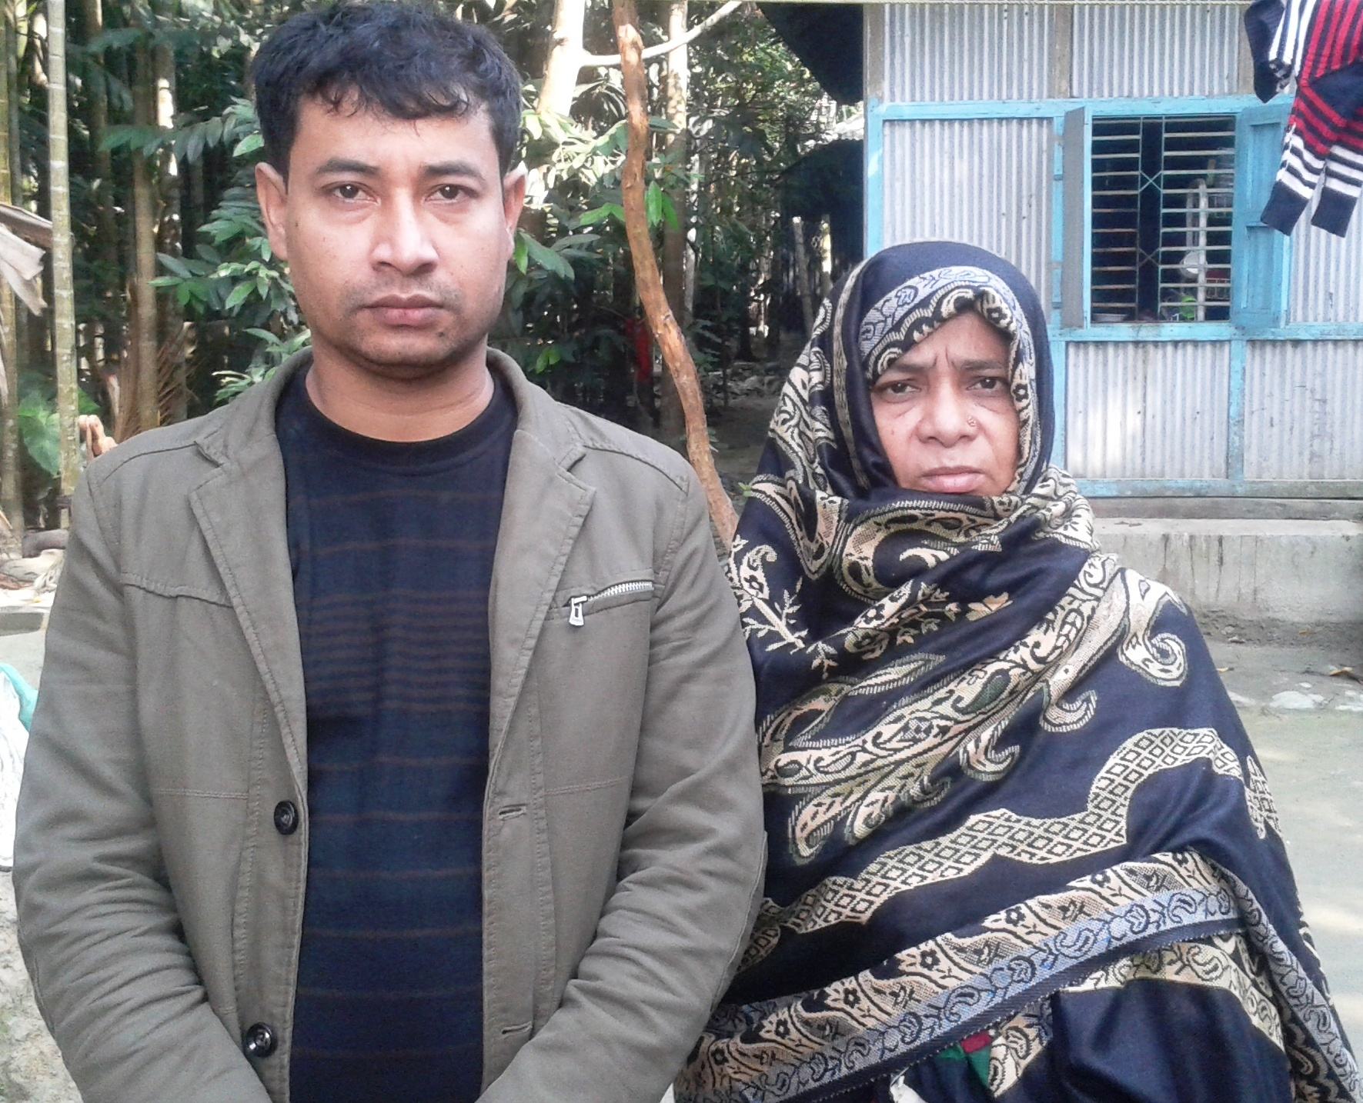

Slide 13
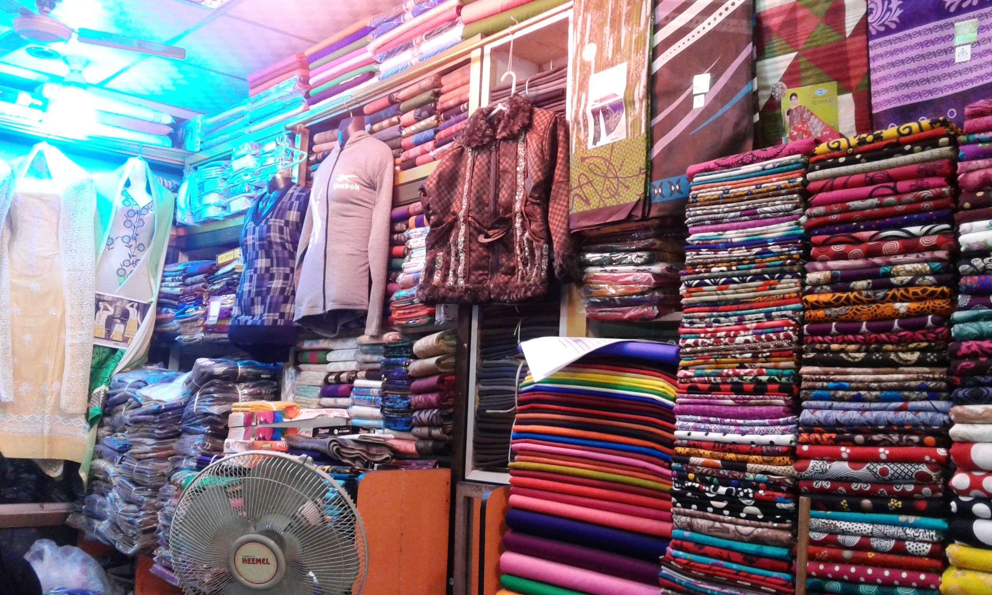

Slide 14
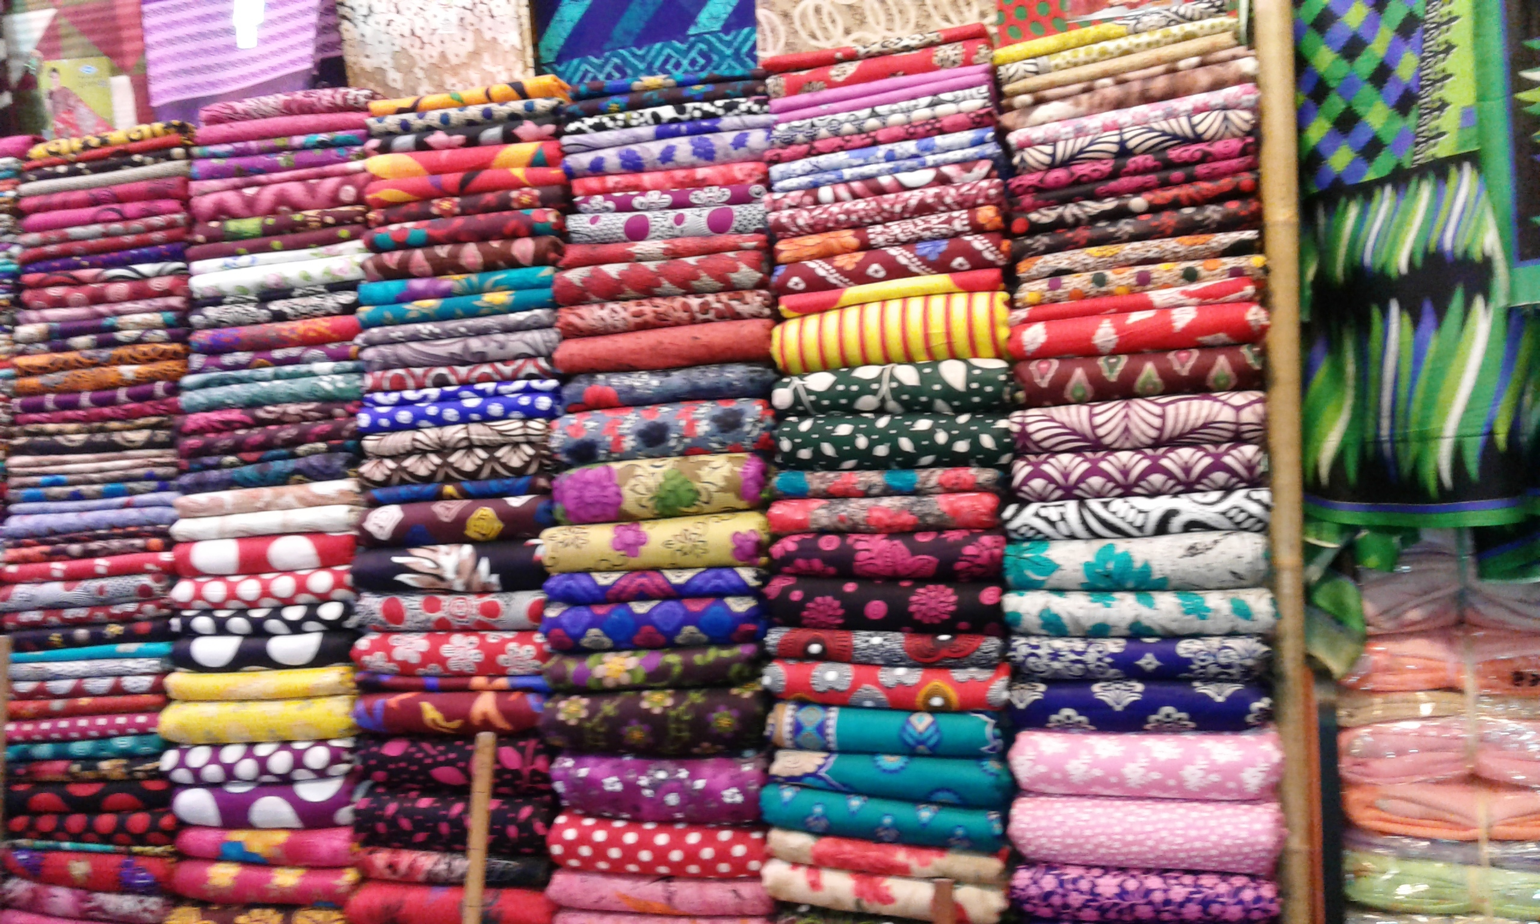

Slide 15
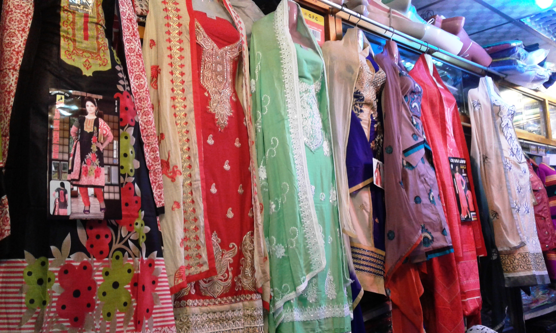

Slide 16
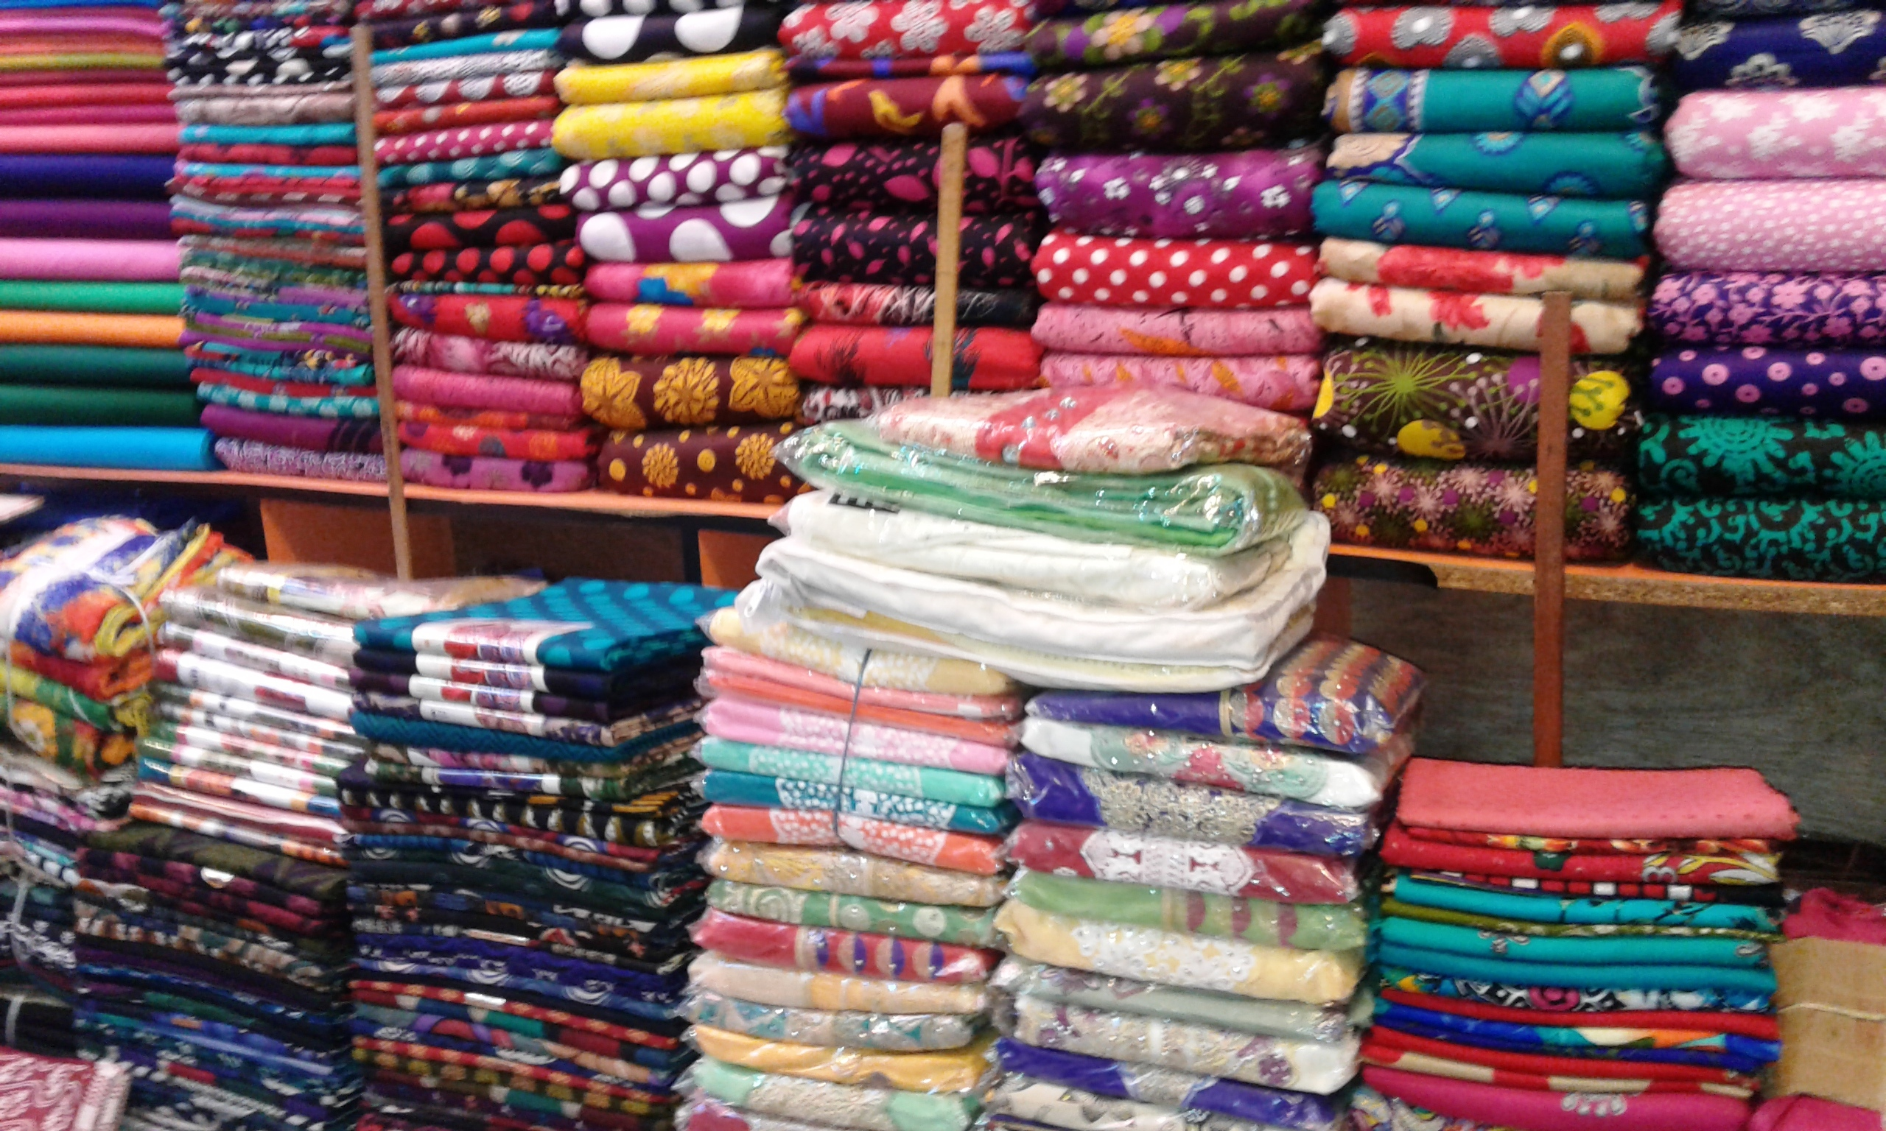

Slide 17
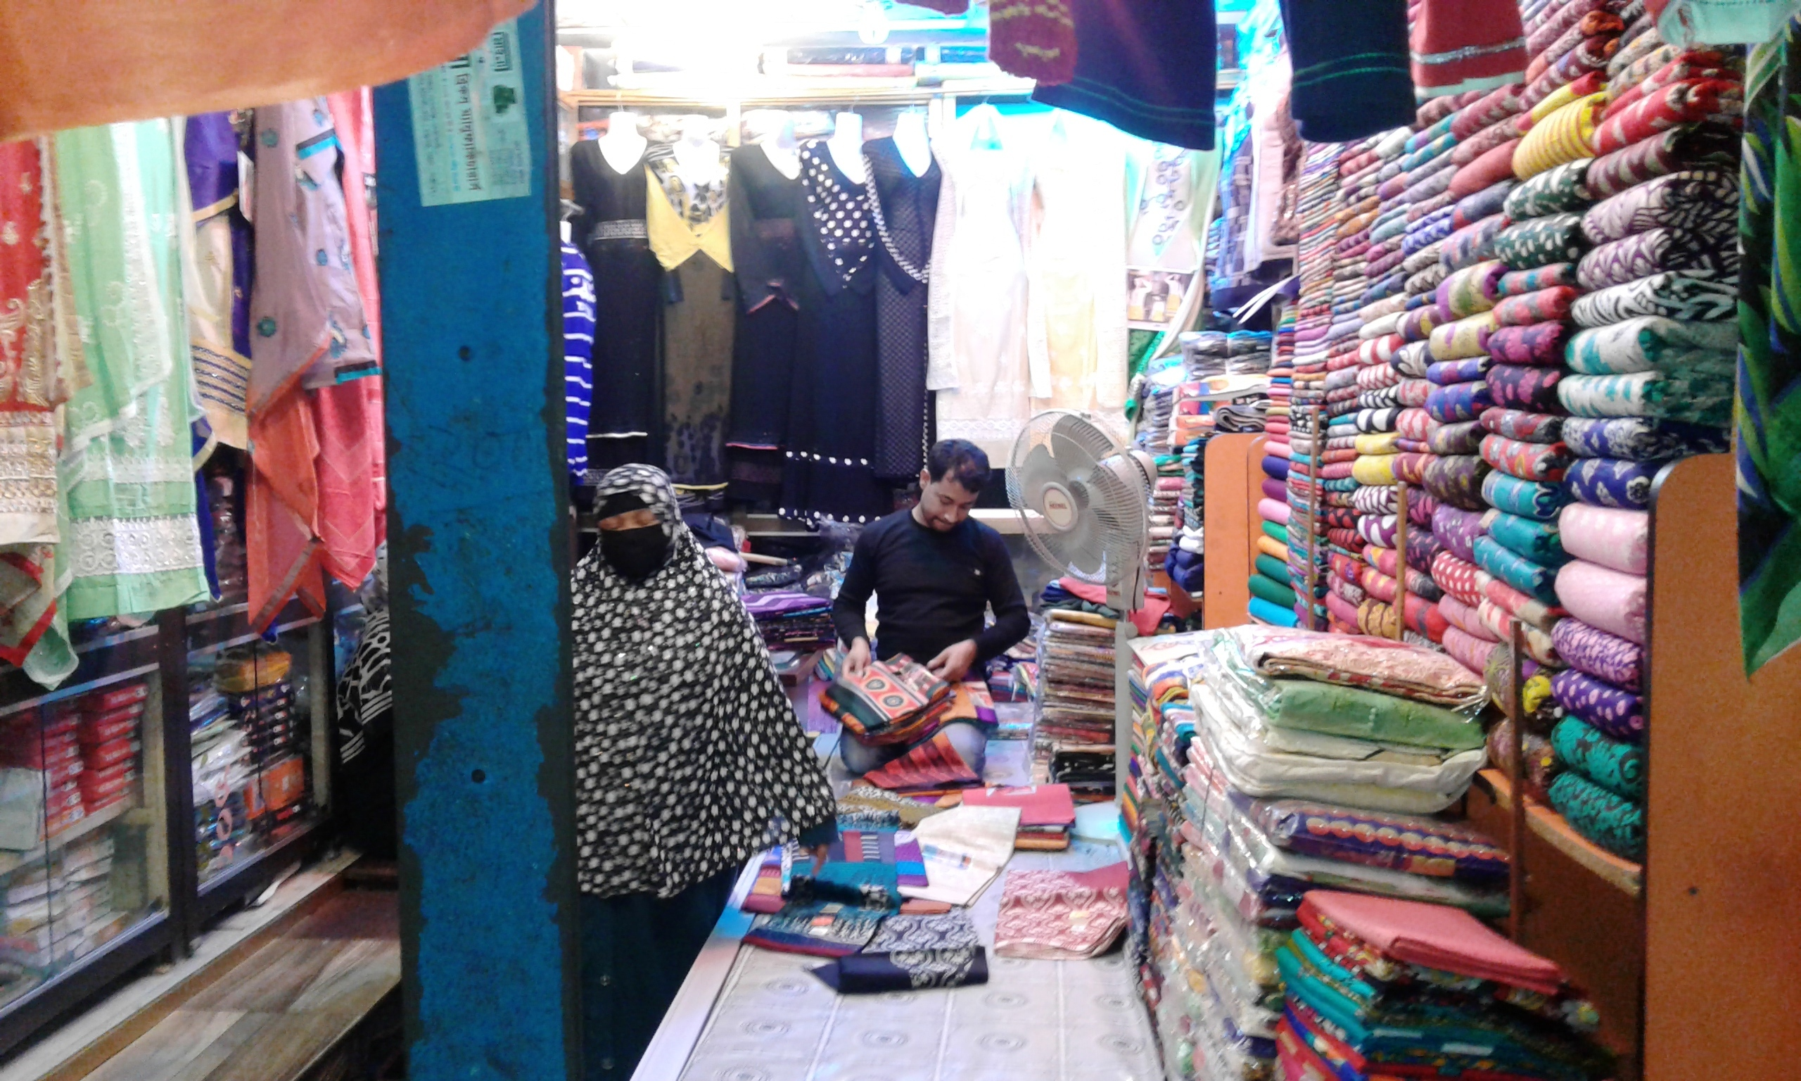

Slide 18
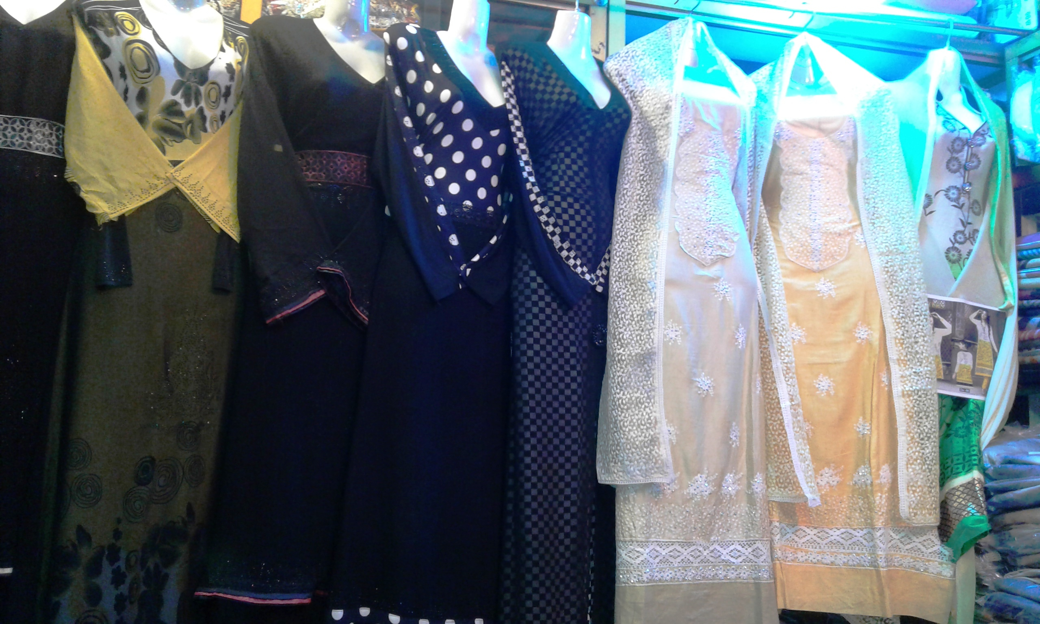

Slide 19
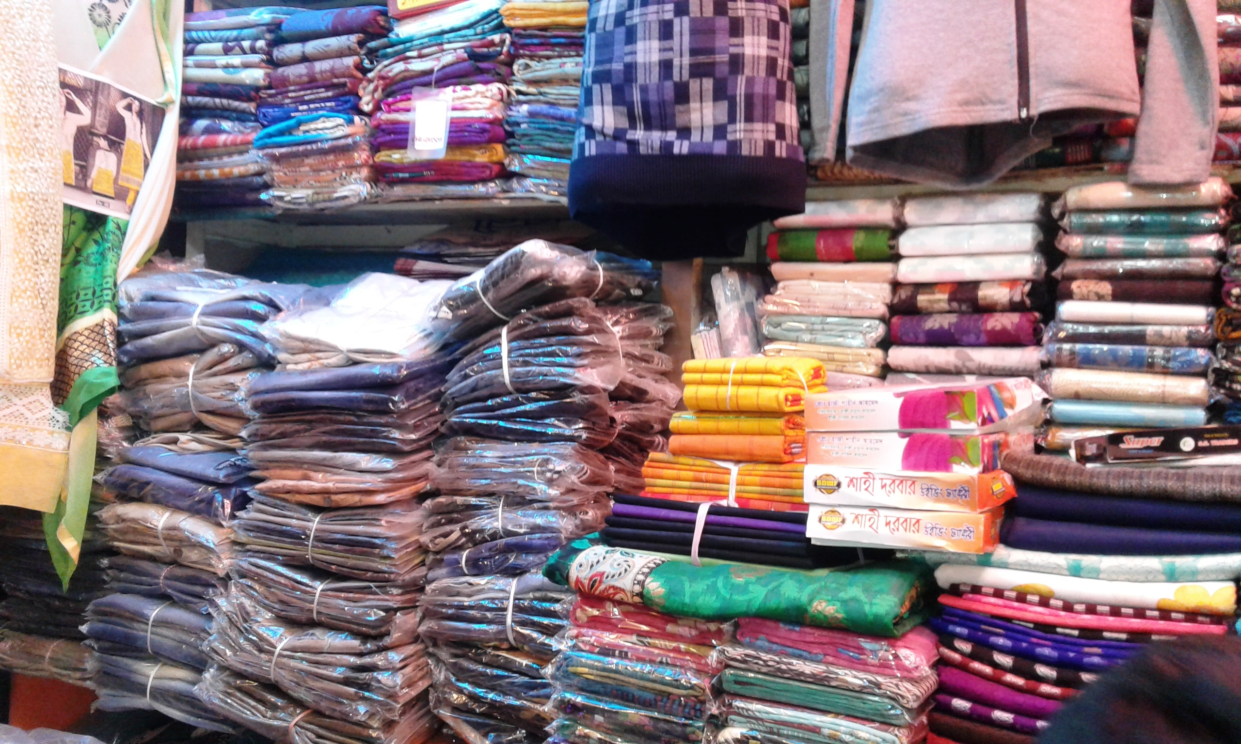

Slide 20
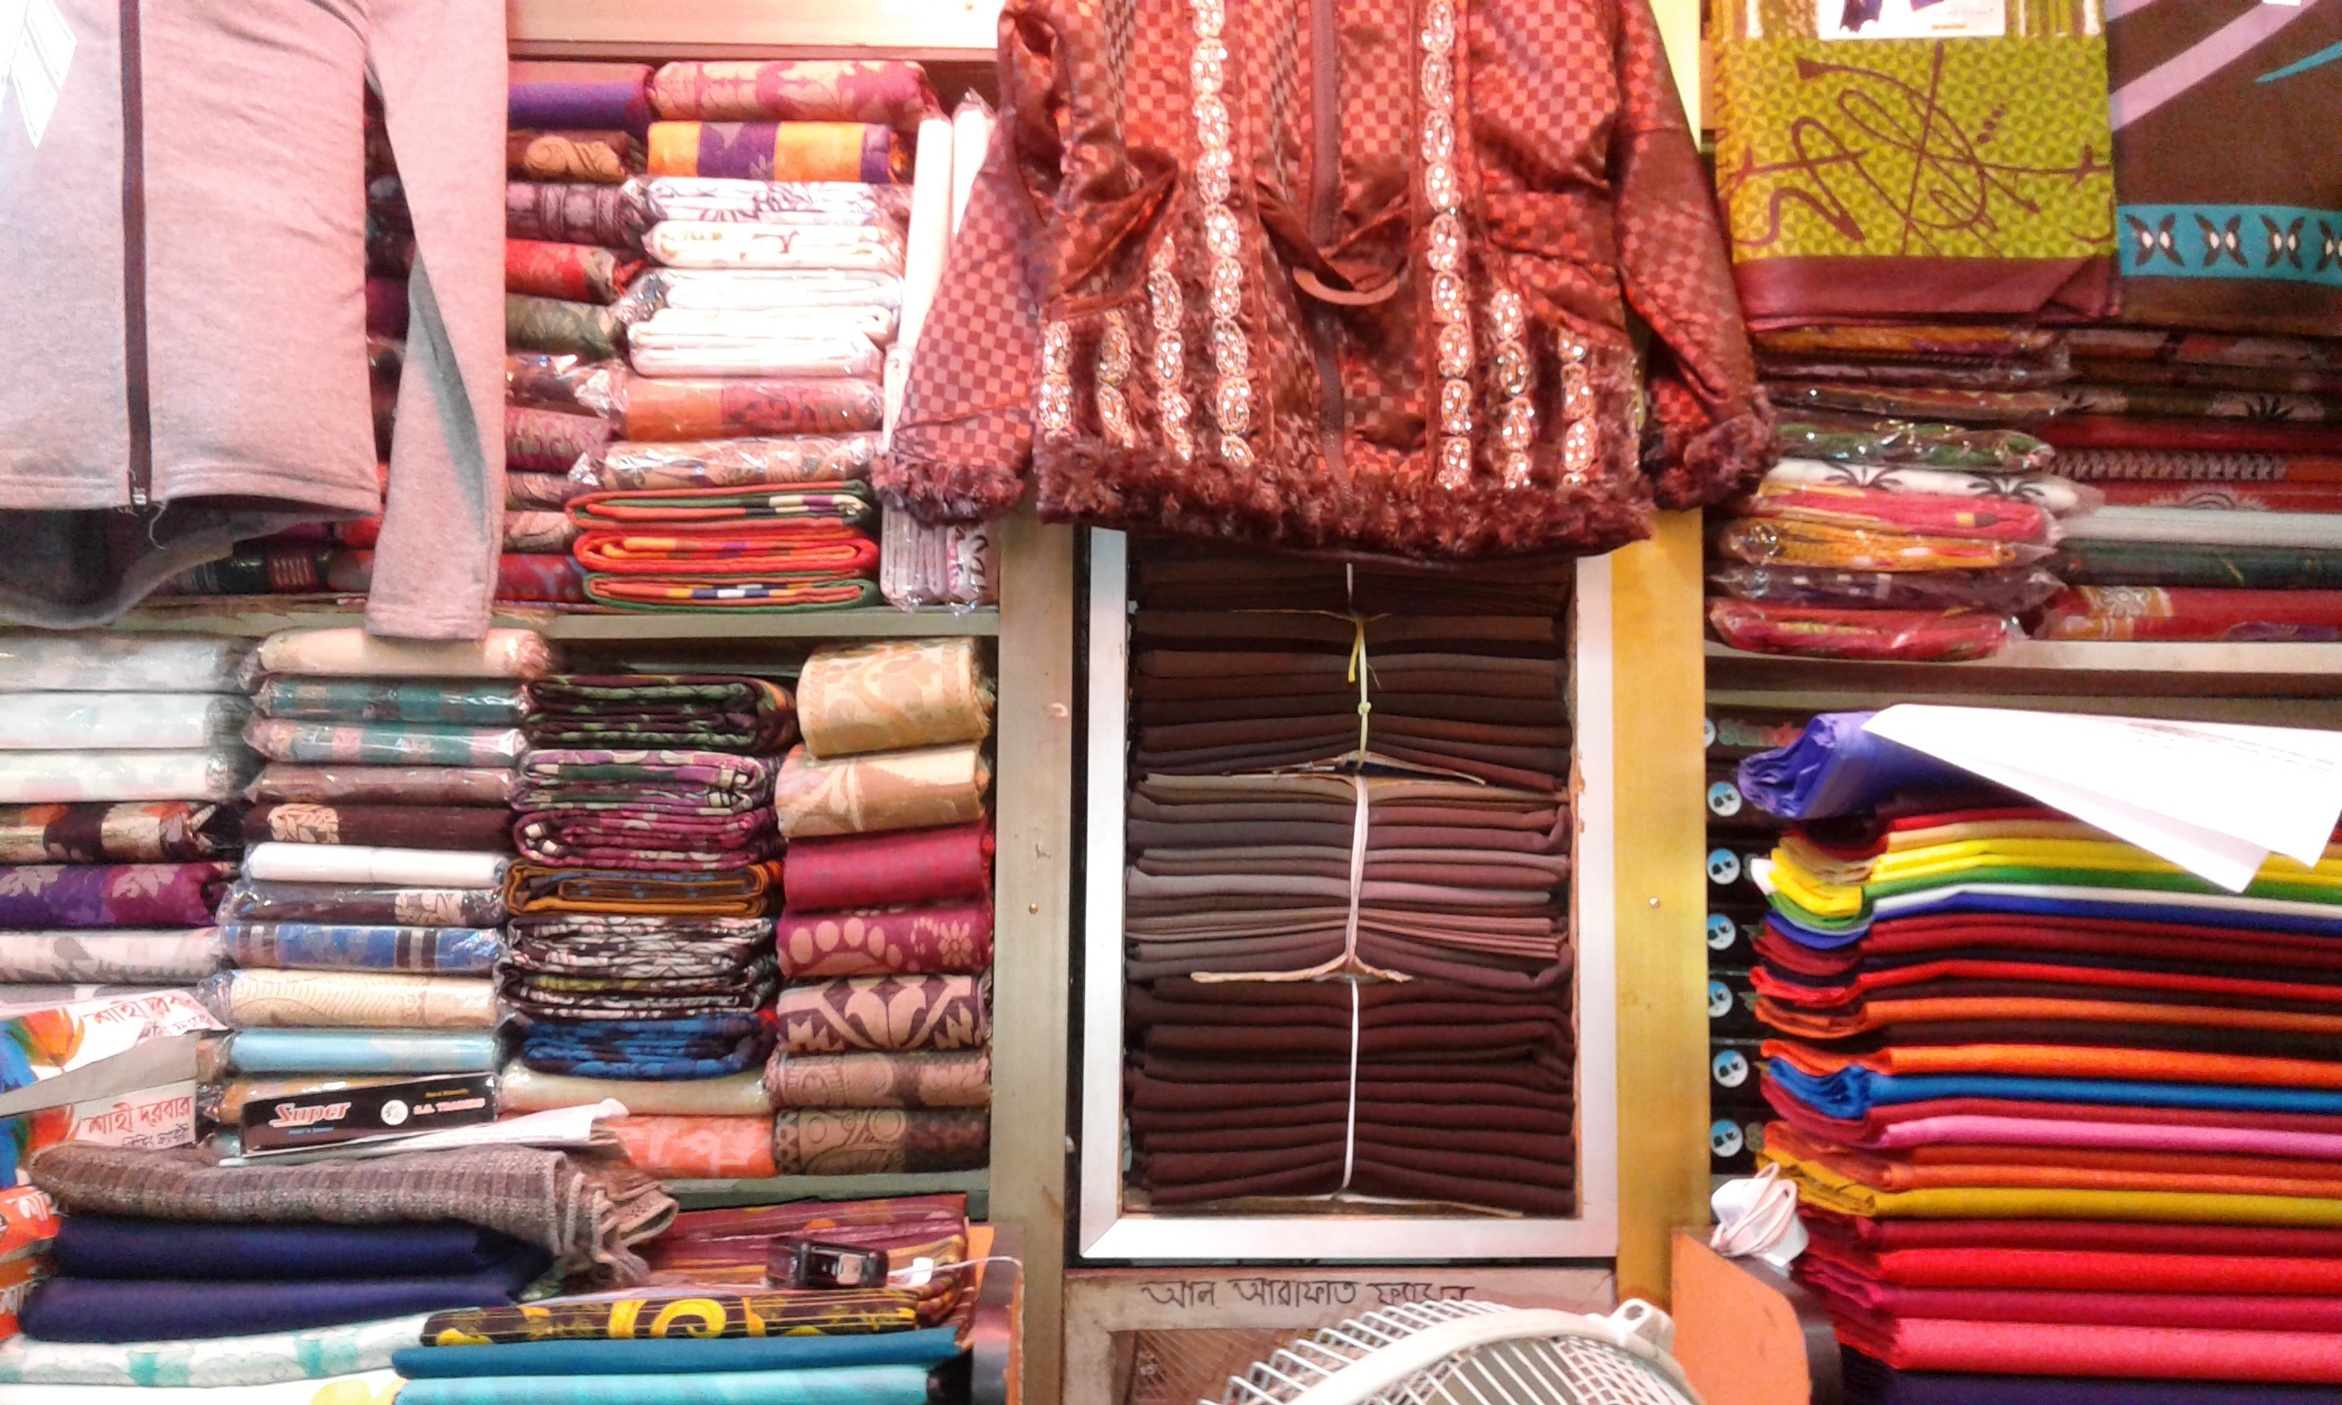

Slide 21
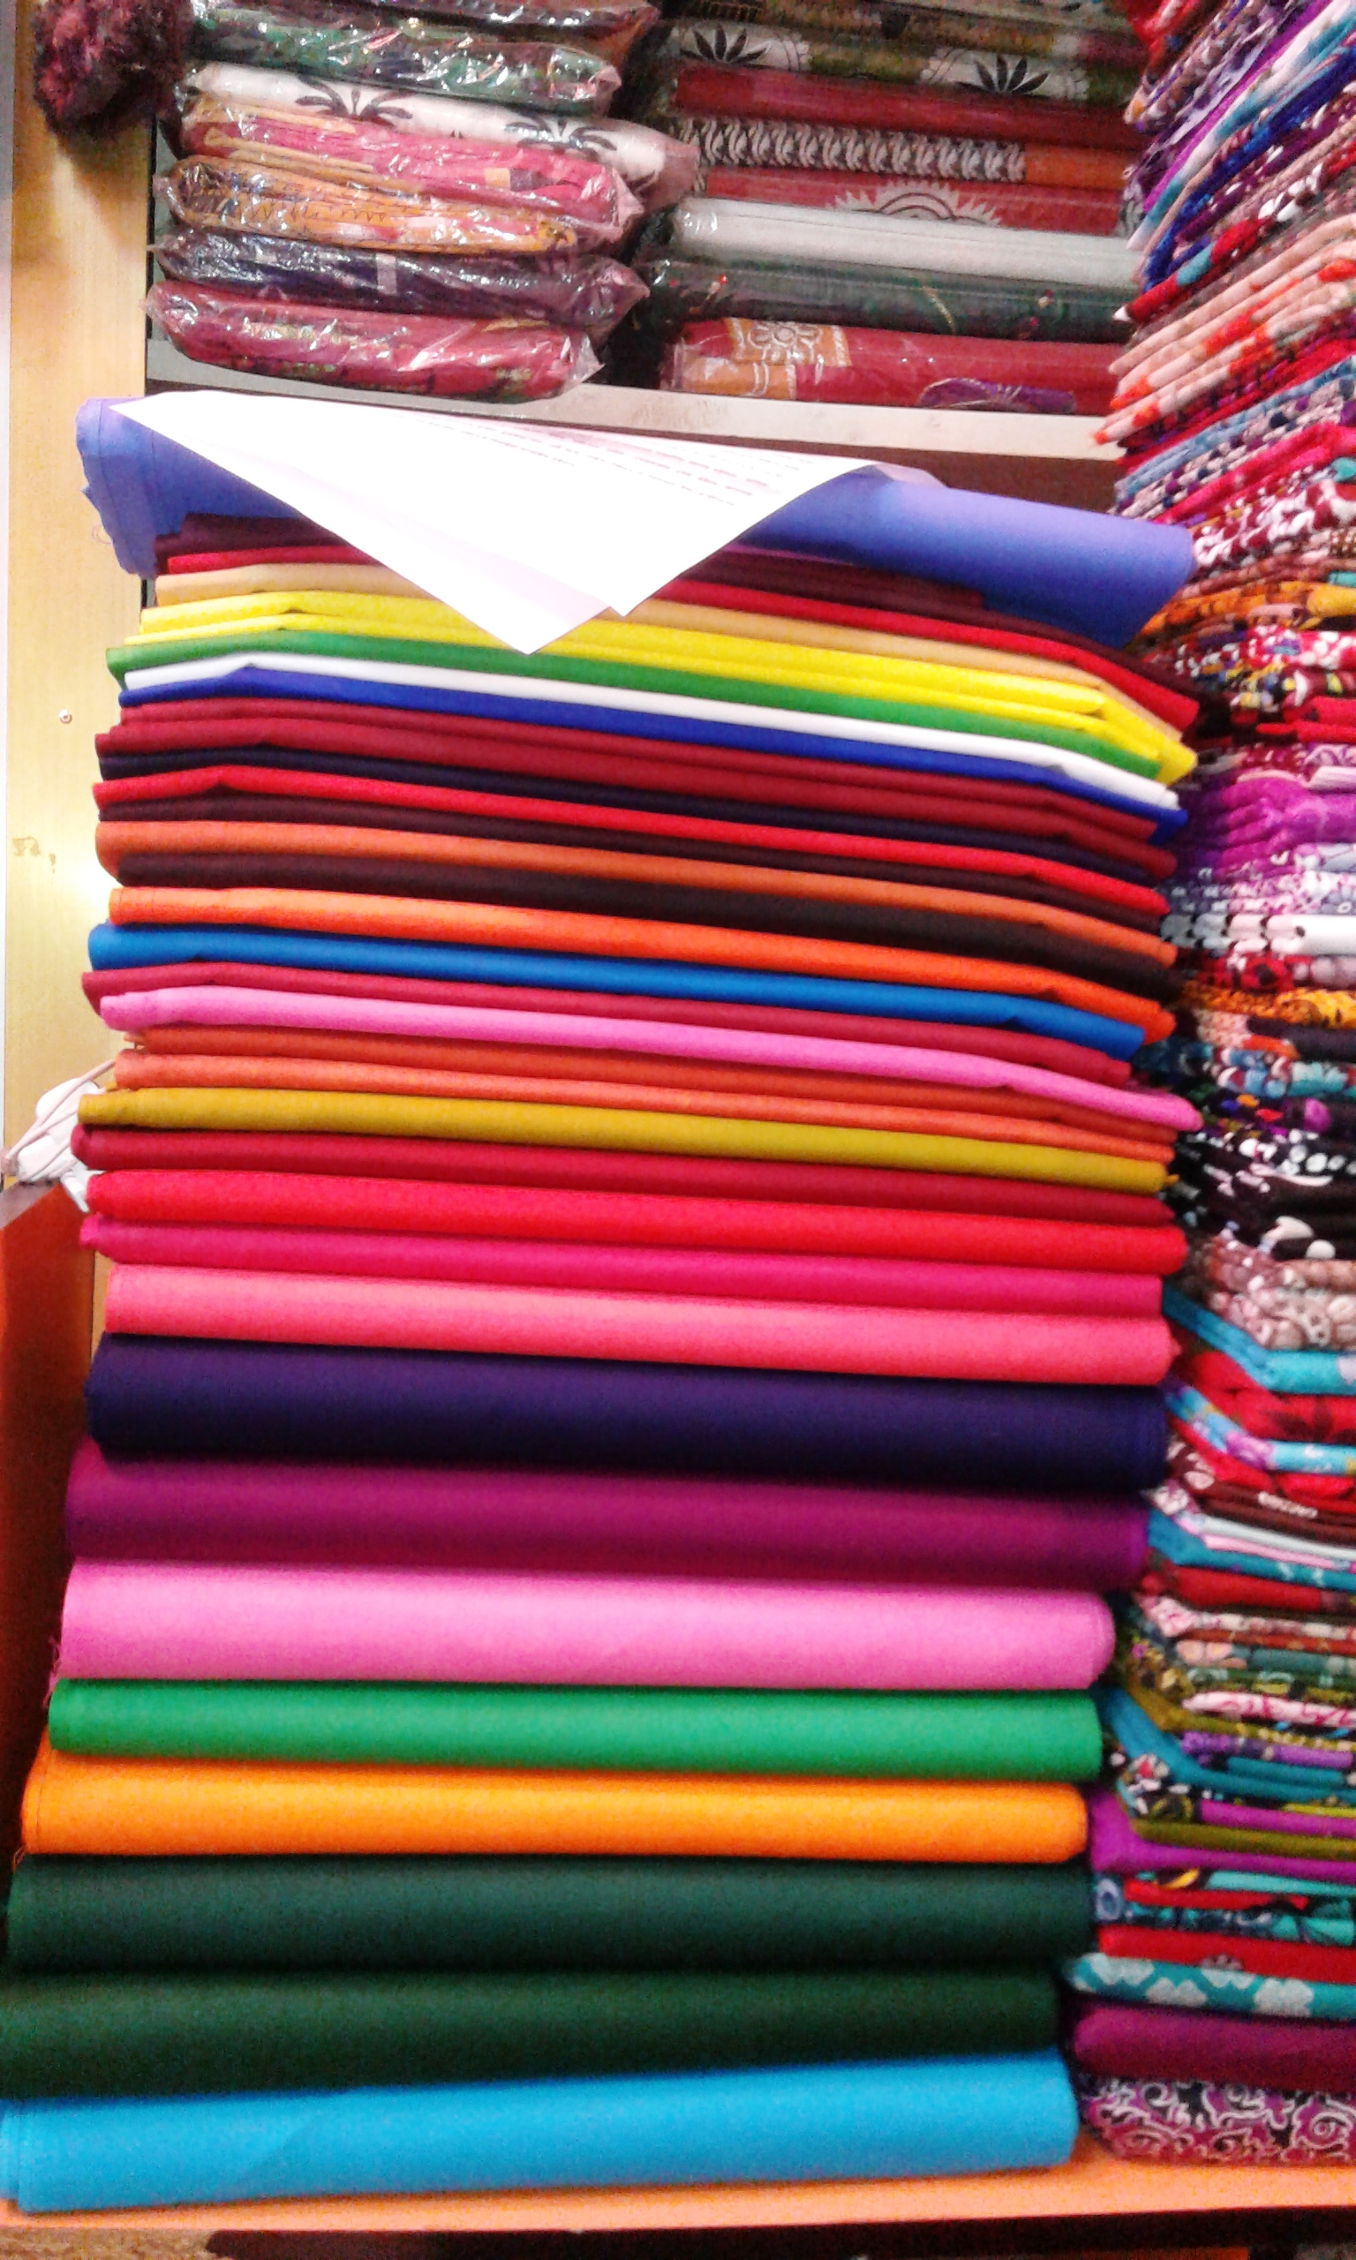

Slide 22
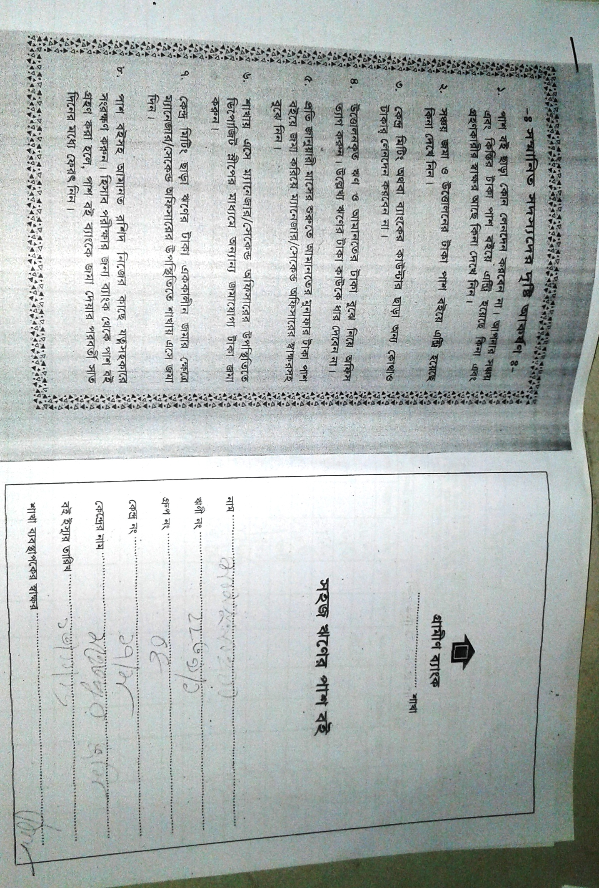
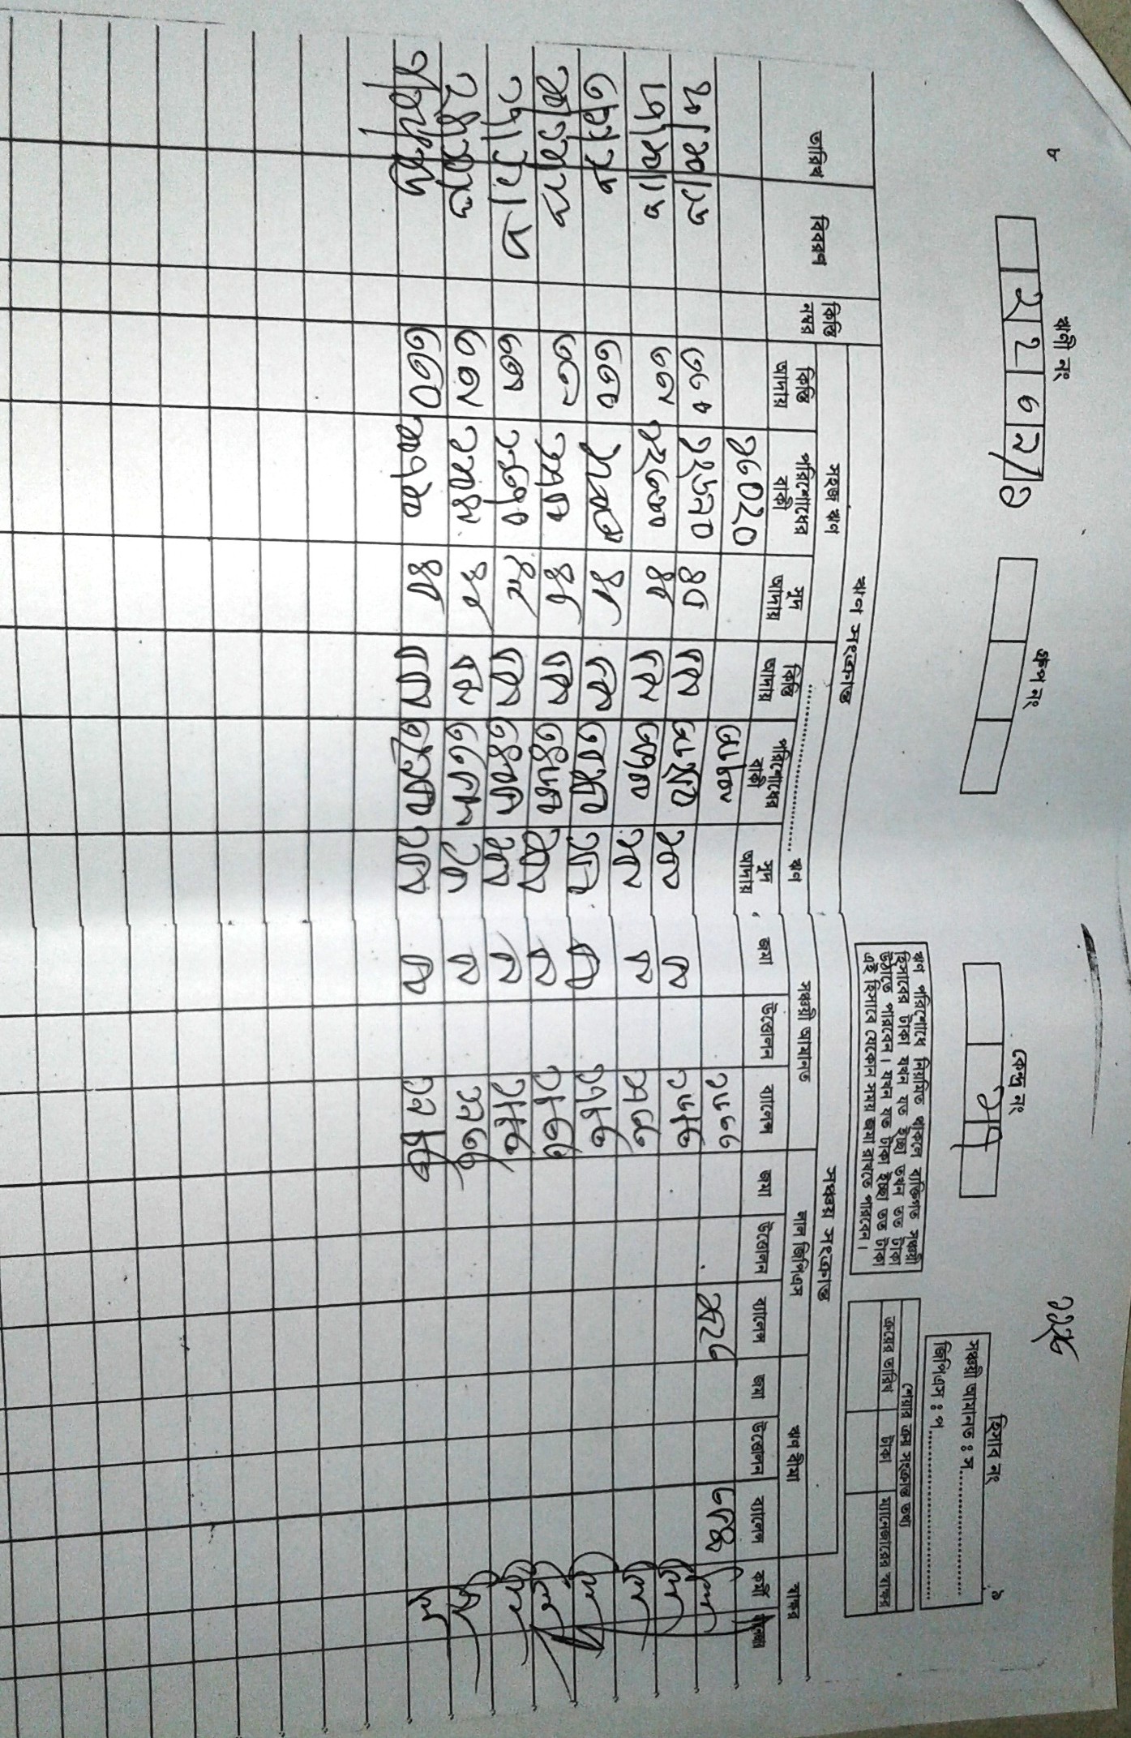

Slide 23
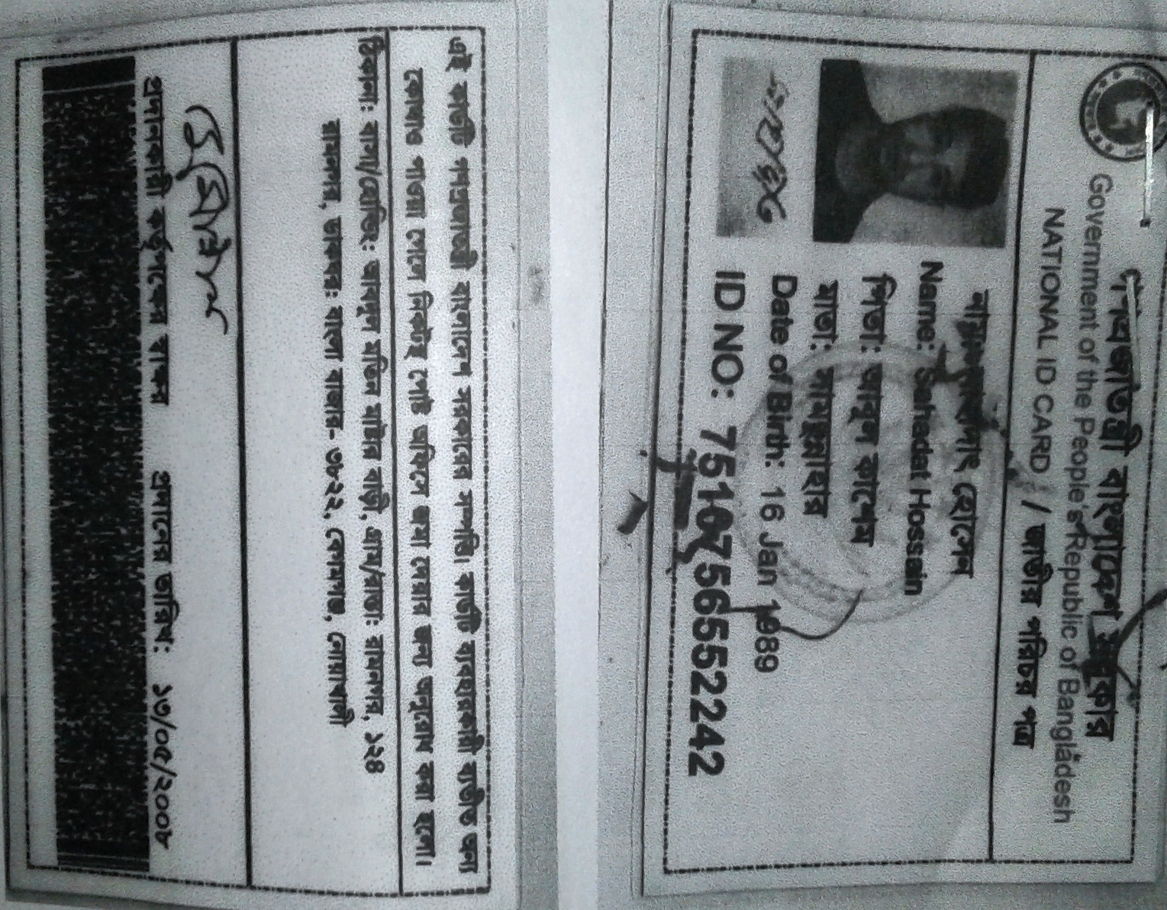

Slide 24
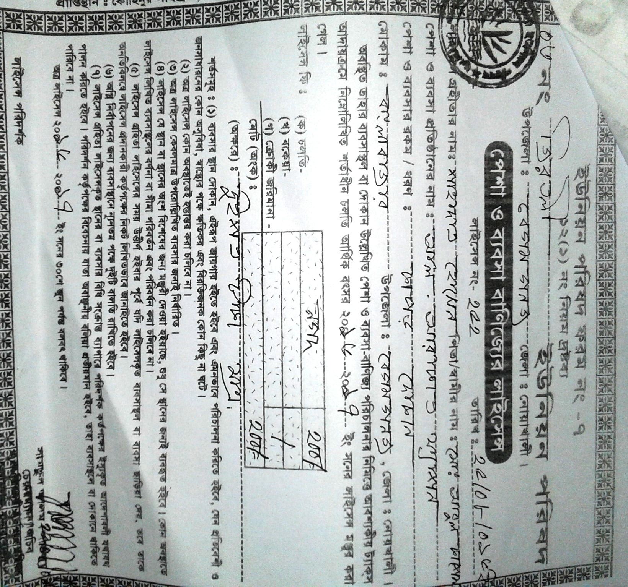

Slide 25
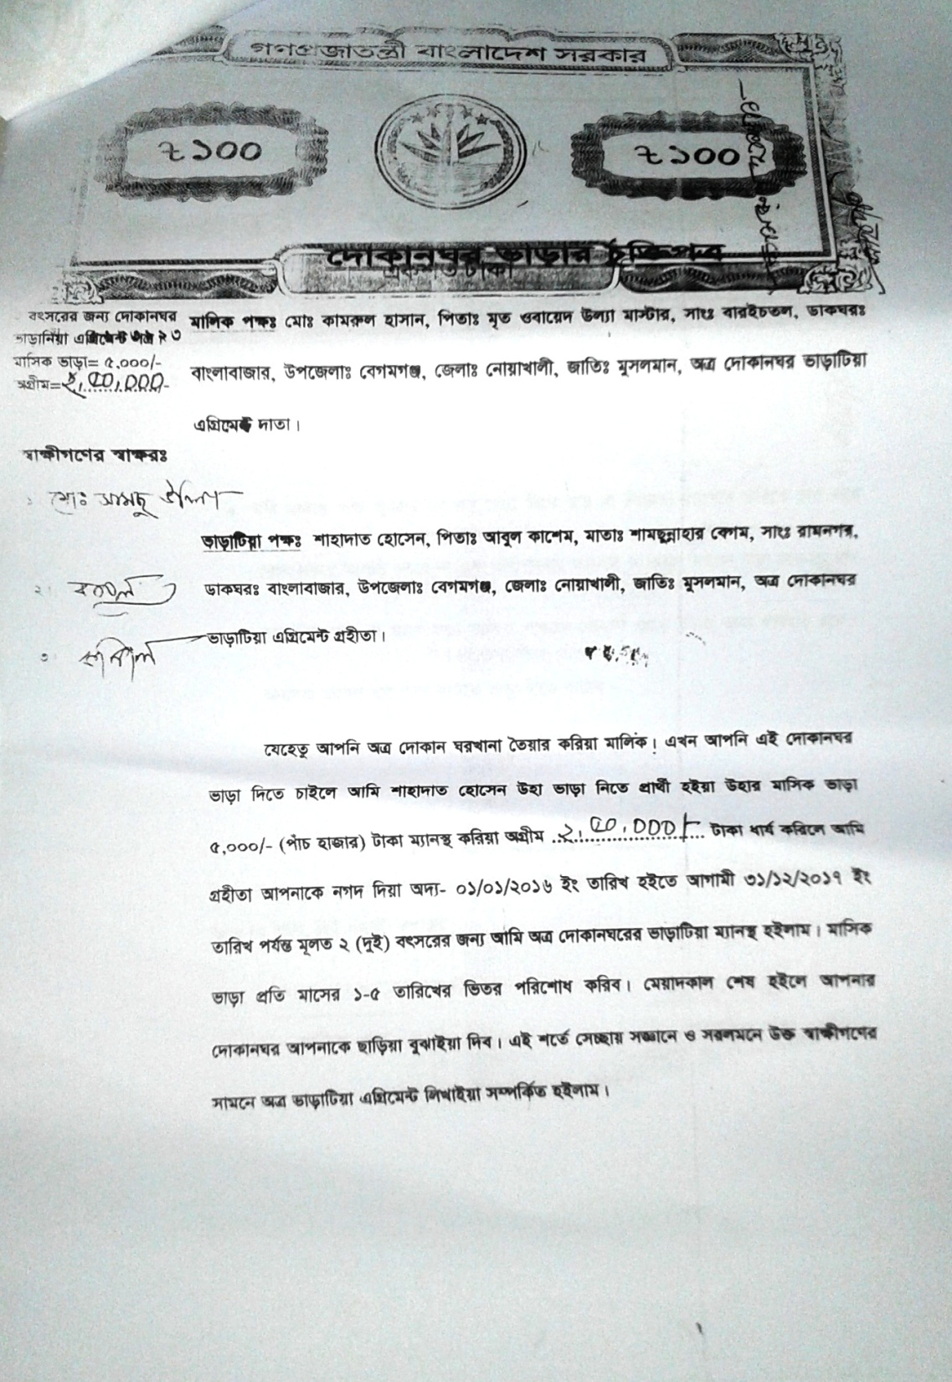
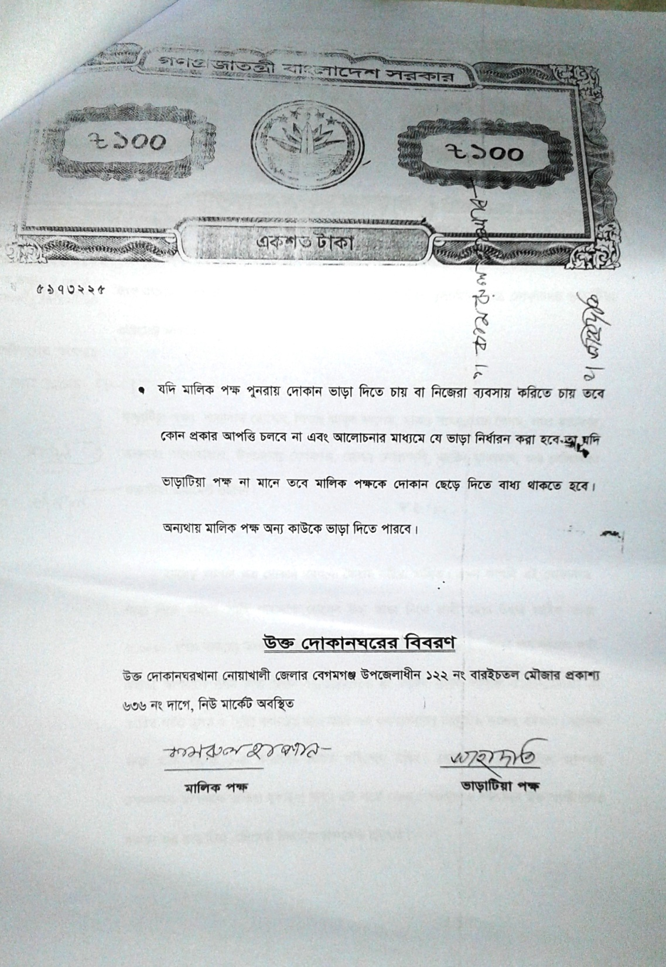

Slide 26
Presented at
SB Internal Design Lab
On January, 2017
For more information
Grameen Trust
Phone No : 9017038
Md. Sahadat Hossain
Cell No: +8801836-360054

